Slide 1


ChowHub
Streamlining Restaurant Management
By
Mostafa Hasanalipourshahrabadi
Tingchen Tsao
Lily Huang
Furkan Bas
Saad Ghori
January – August 2025

Slide 2





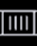



Problem Statement: Addressing Key Restaurant Challenges
Restaurants face a myriad of challenges that can impact their profitability and customer satisfaction. ChowHub aims to solve these issues and bring more efficiency.
Inefficient Inventory Tracking
Leading to stockouts, overstocking, and increased costs.
Ingredient Waste & Shortages
Negatively impacting profitability and customer satisfaction.
Manual Processes
For scheduling, payroll, and reporting are time-consuming and prone to errors.
Lack of System Integration
Causing data silos and operational inefficiencies across departments.

Slide 3









Solution Vision: Centralized All-in-One System
Restaurants face a myriad of challenges that can impact their profitability and customer satisfaction. ChowHub aims to solve these issues and bring more efficiency.
Real-Time Inventory Tracking
Minimize waste and optimize reordering with accurate ingredient tracking.
Automatic Menu Updates
Quickly adapt to ingredient availability and decrease cancellations.
Sales and Performance Analytics
Offers sales and performance analytics
Optimized Employee Shift Scheduling and Payroll
Streamline workforce management with automated operations.

Slide 4



Project Scopes and Constraints
In-Scope Features
* Menu management
* Inventory and supplier tracking
* Employee scheduling and payroll
* Sales reports and analytics
* Role-based user access
* Compliance with PIPEDA and AODA standards
Out-of-Scope Features
* Mobile app development
* Full POS System
* Employee scheduling and payroll
* AI Forecasting
* Royalty Programs & Marketing

Slide 5
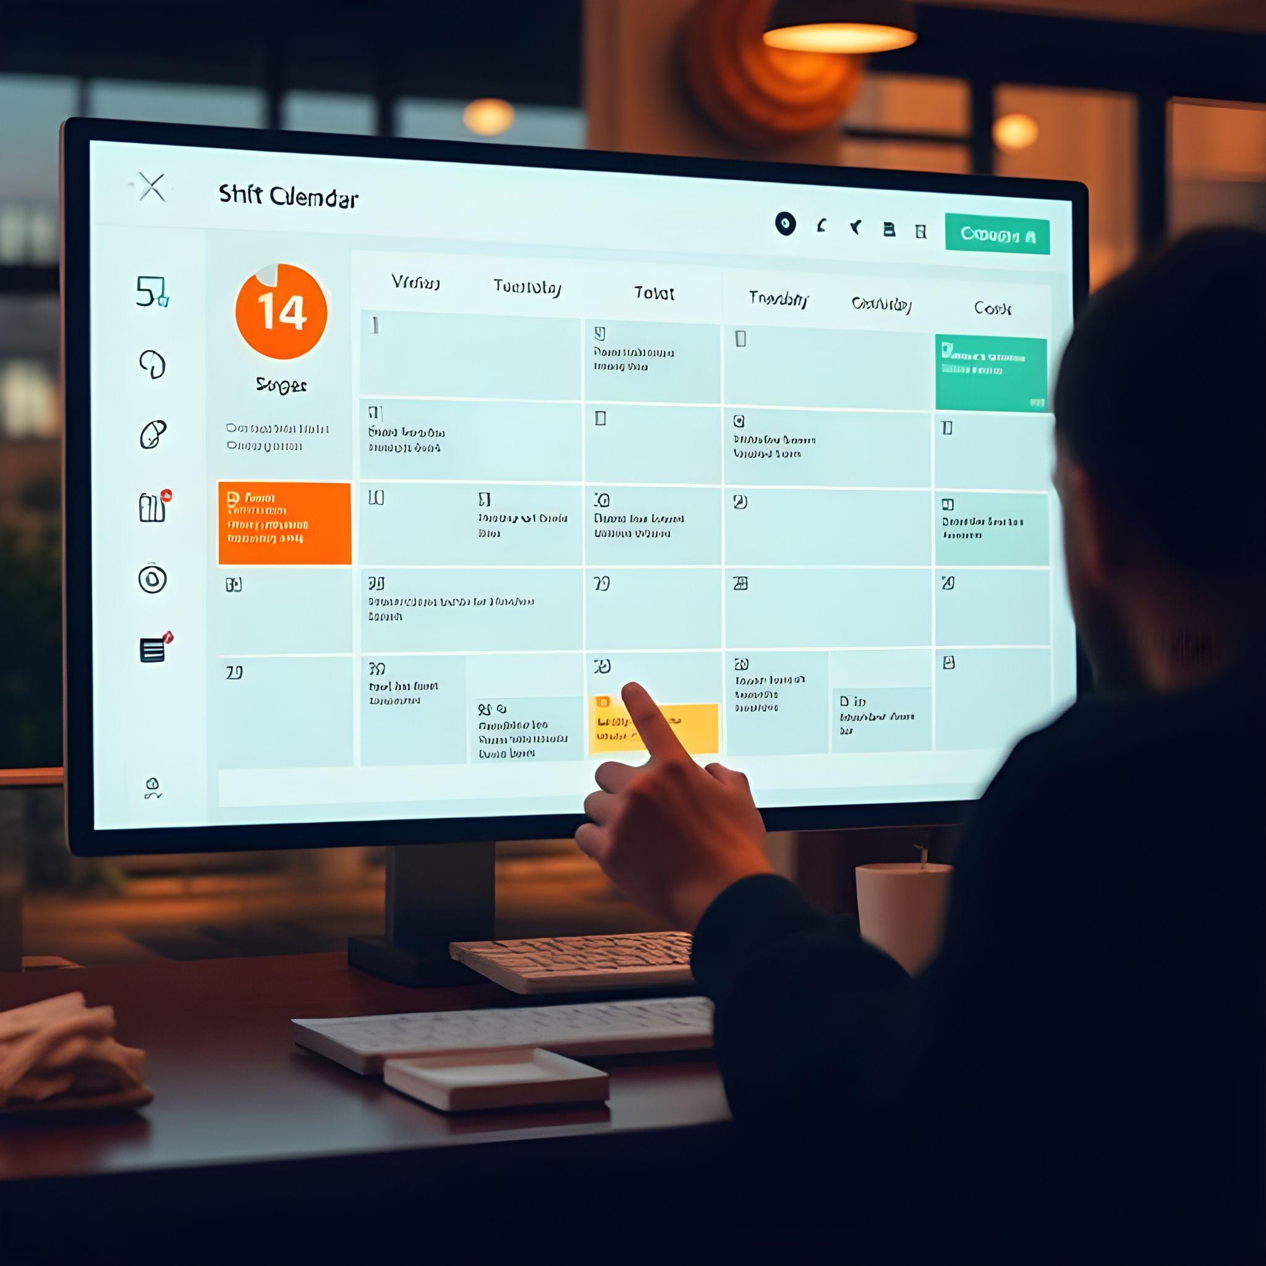
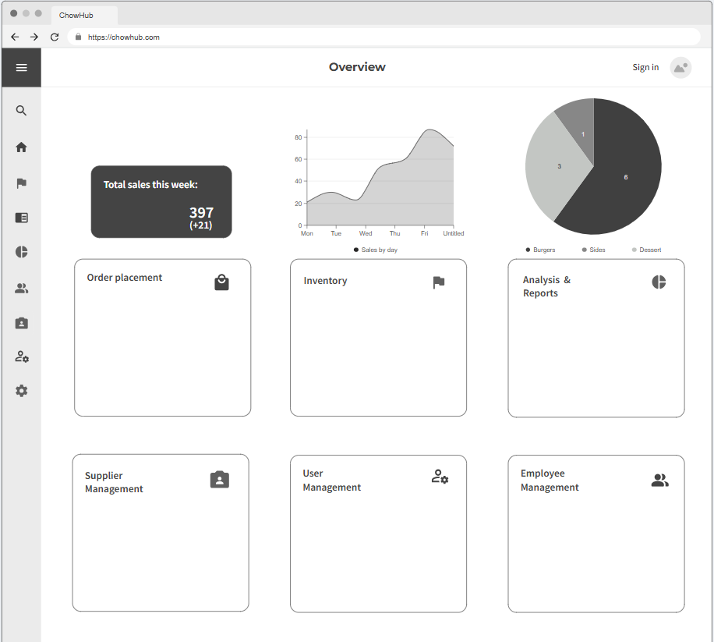

Overview/Main menu
Notes:
Hi my name is Tingchen and I will be demonstrating the user management, including sign in and how manager can add users to the system, now the current page is the main page of our application, and we can start by signing in our manager (assume manager is already registered in the system) by clicking the sign in button on the top right corner.

Slide 6
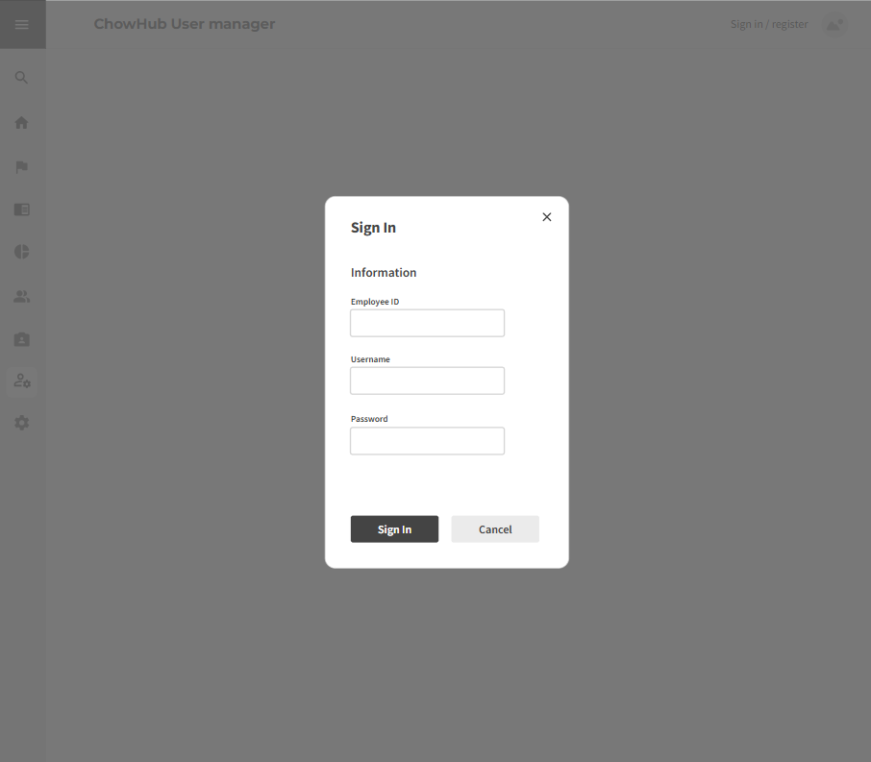
User Management
Sign in
Notes:
And we will need to fill in the user data for the manager to sign in

Slide 7
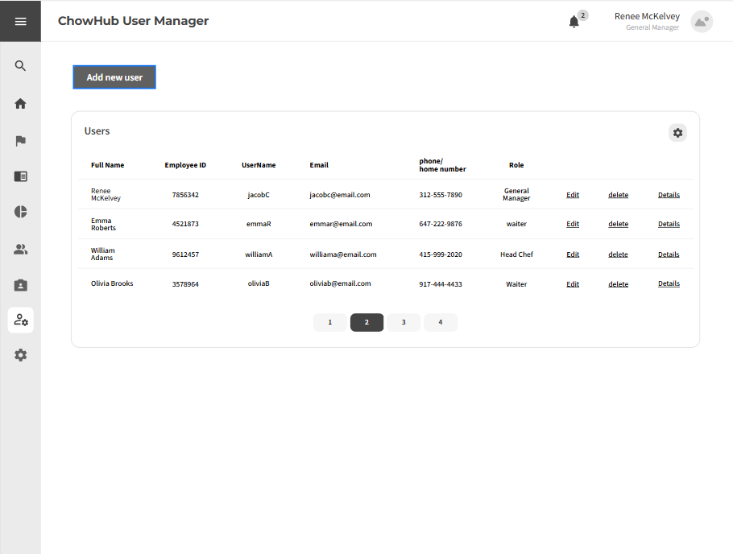
User Management
Add user
Notes:
After signing in, we will see this user manager page, which we can see all users in a list, and there is couple of actions we can do in this page which will be add, edit delete, or check user detail and we are demonstrating add user today, by clicking on the add new user button

Slide 8
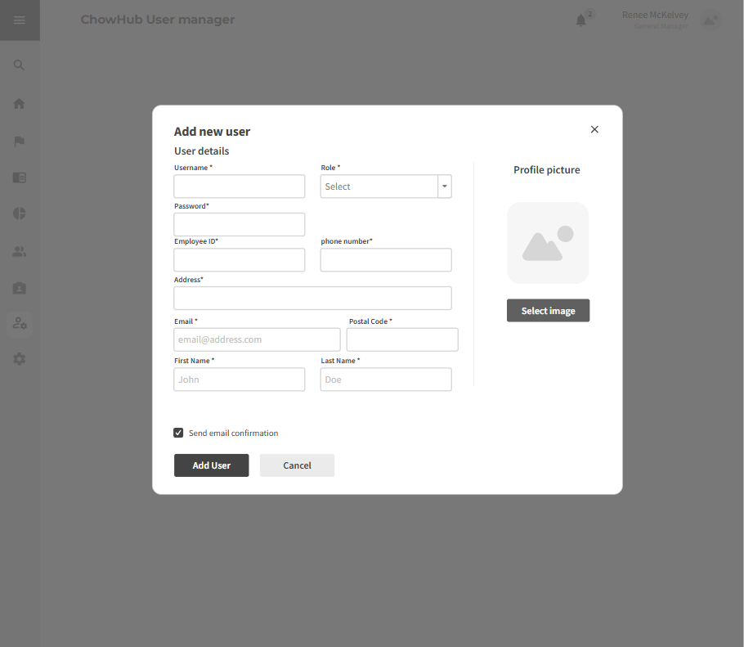
User Management
Add user
Notes:
It will bring out the add new user form, which we will need to fill up all the required field marked by star symble. And than add user

Slide 9
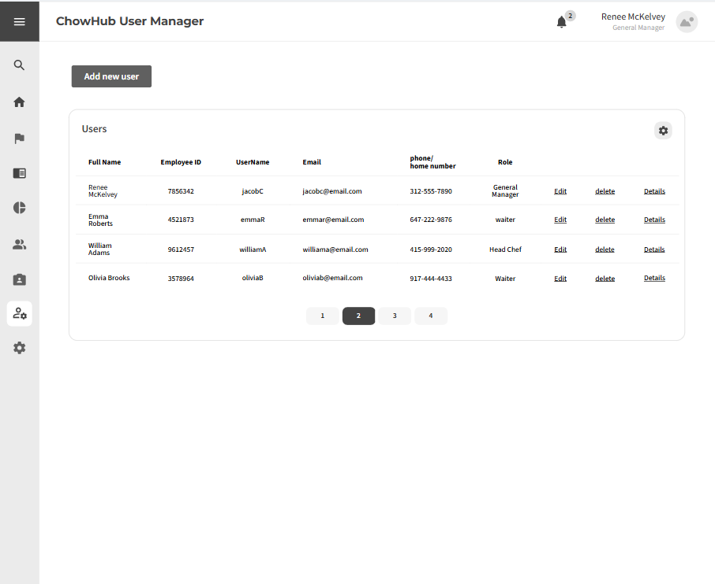
User Management
Add user
Notes:
And the newly added user info will be displayed in this user list. And next slides will be covered by saad ghori

Slide 10

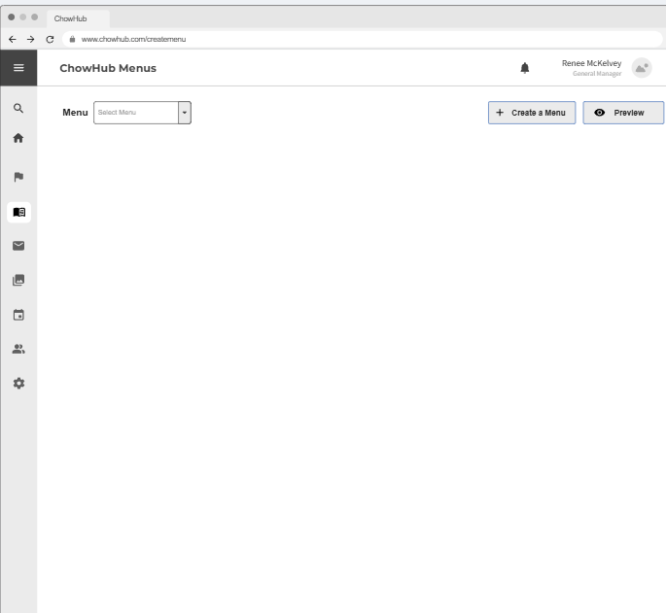
Menu Management Selecting Menu

Slide 11
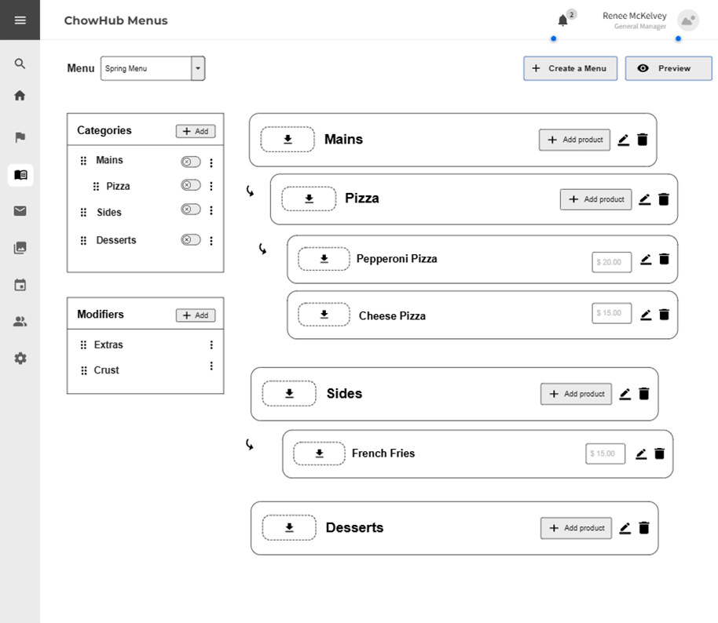
Menu Management Editing Menu

Slide 12

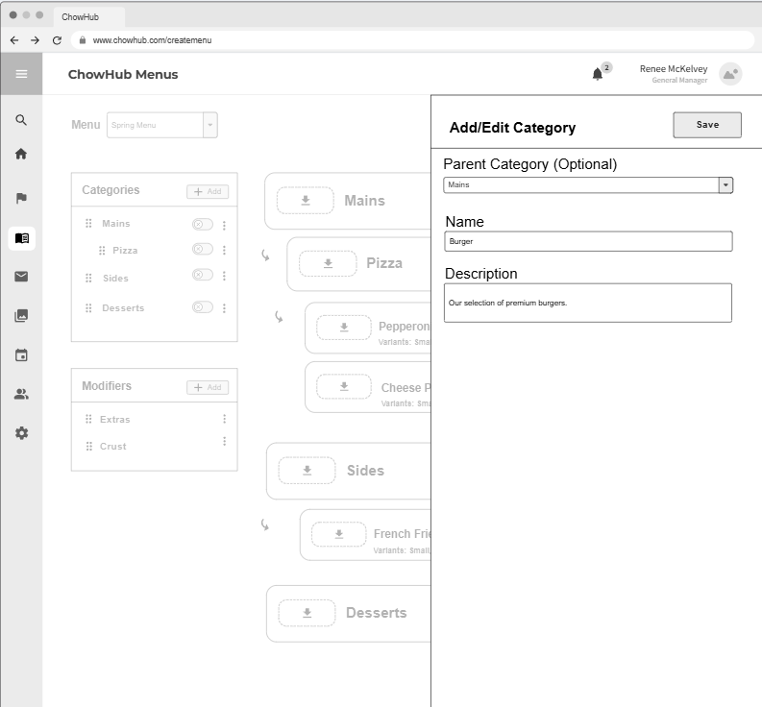
Menu Management Add Category

Slide 13
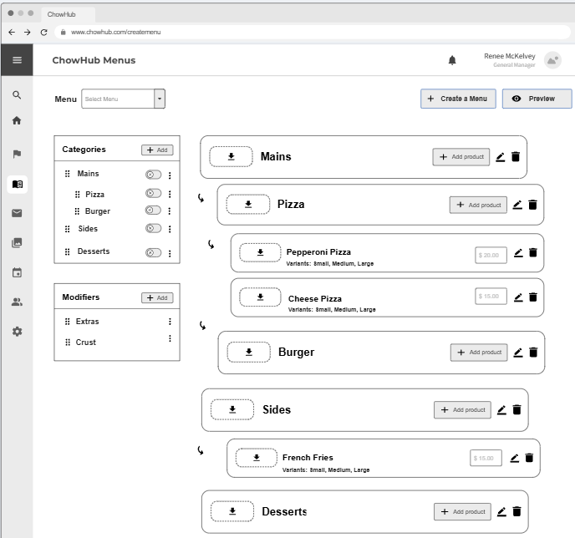
Menu Management Category Added

Slide 14

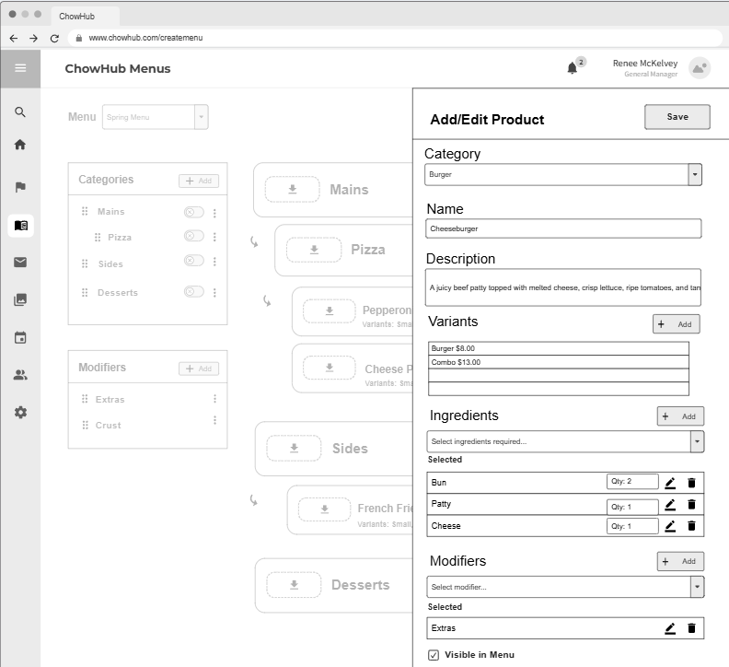
Menu Management Add Menu Item

Slide 15

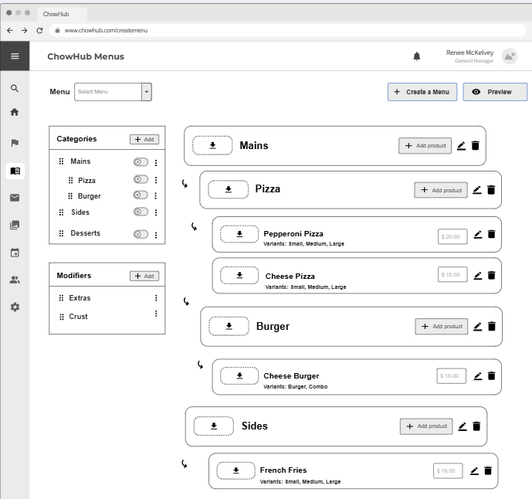
Menu Management Menu Item Added

Slide 16

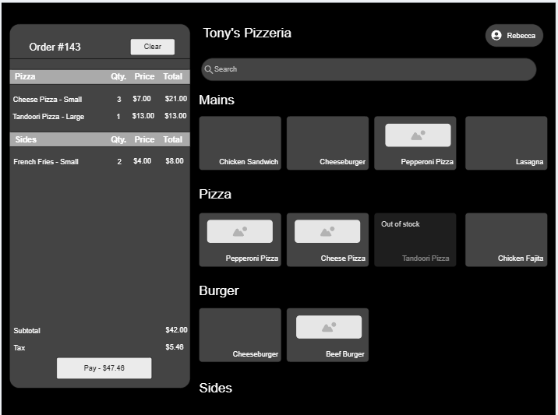
Order Taking Ordering Screen
Notes:
Once the menu has been edited, it will be updated in the order taking module in real-time. This is what the ordering screen will look like. Its sleek, minimal, and designed in a way that is easy to use. On the left we have the current order details, on the right side the menu items are visible. You can see the parent category mains has items from various children categories. And then we have the burger category, and the cheeseburger item that we just created. Now the waiter will add another item the chicken fajita pizza to the order.

Slide 17

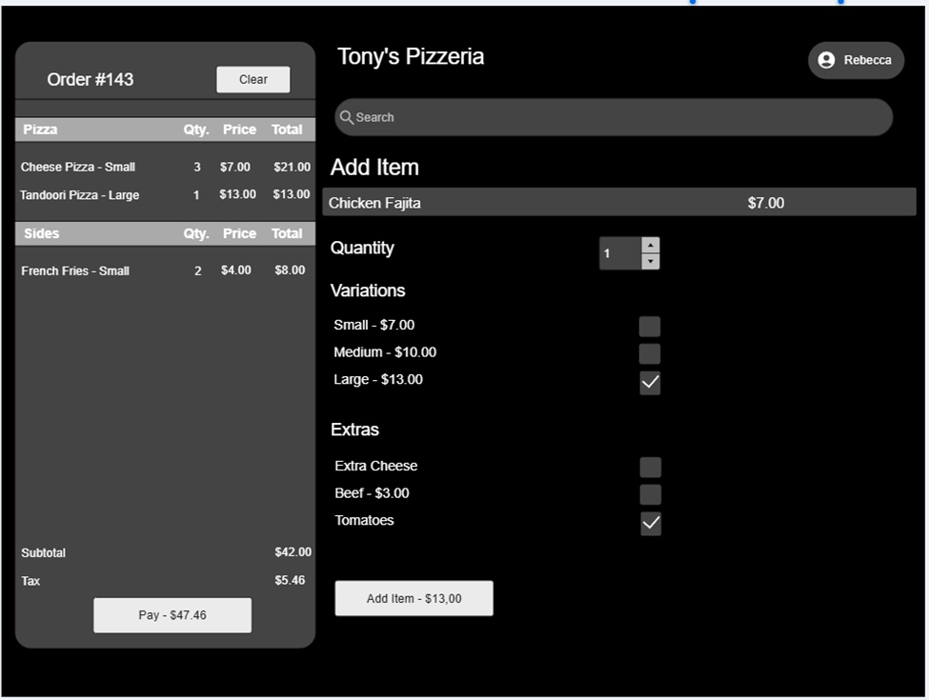
Order Taking Adding Item to Order

Slide 18
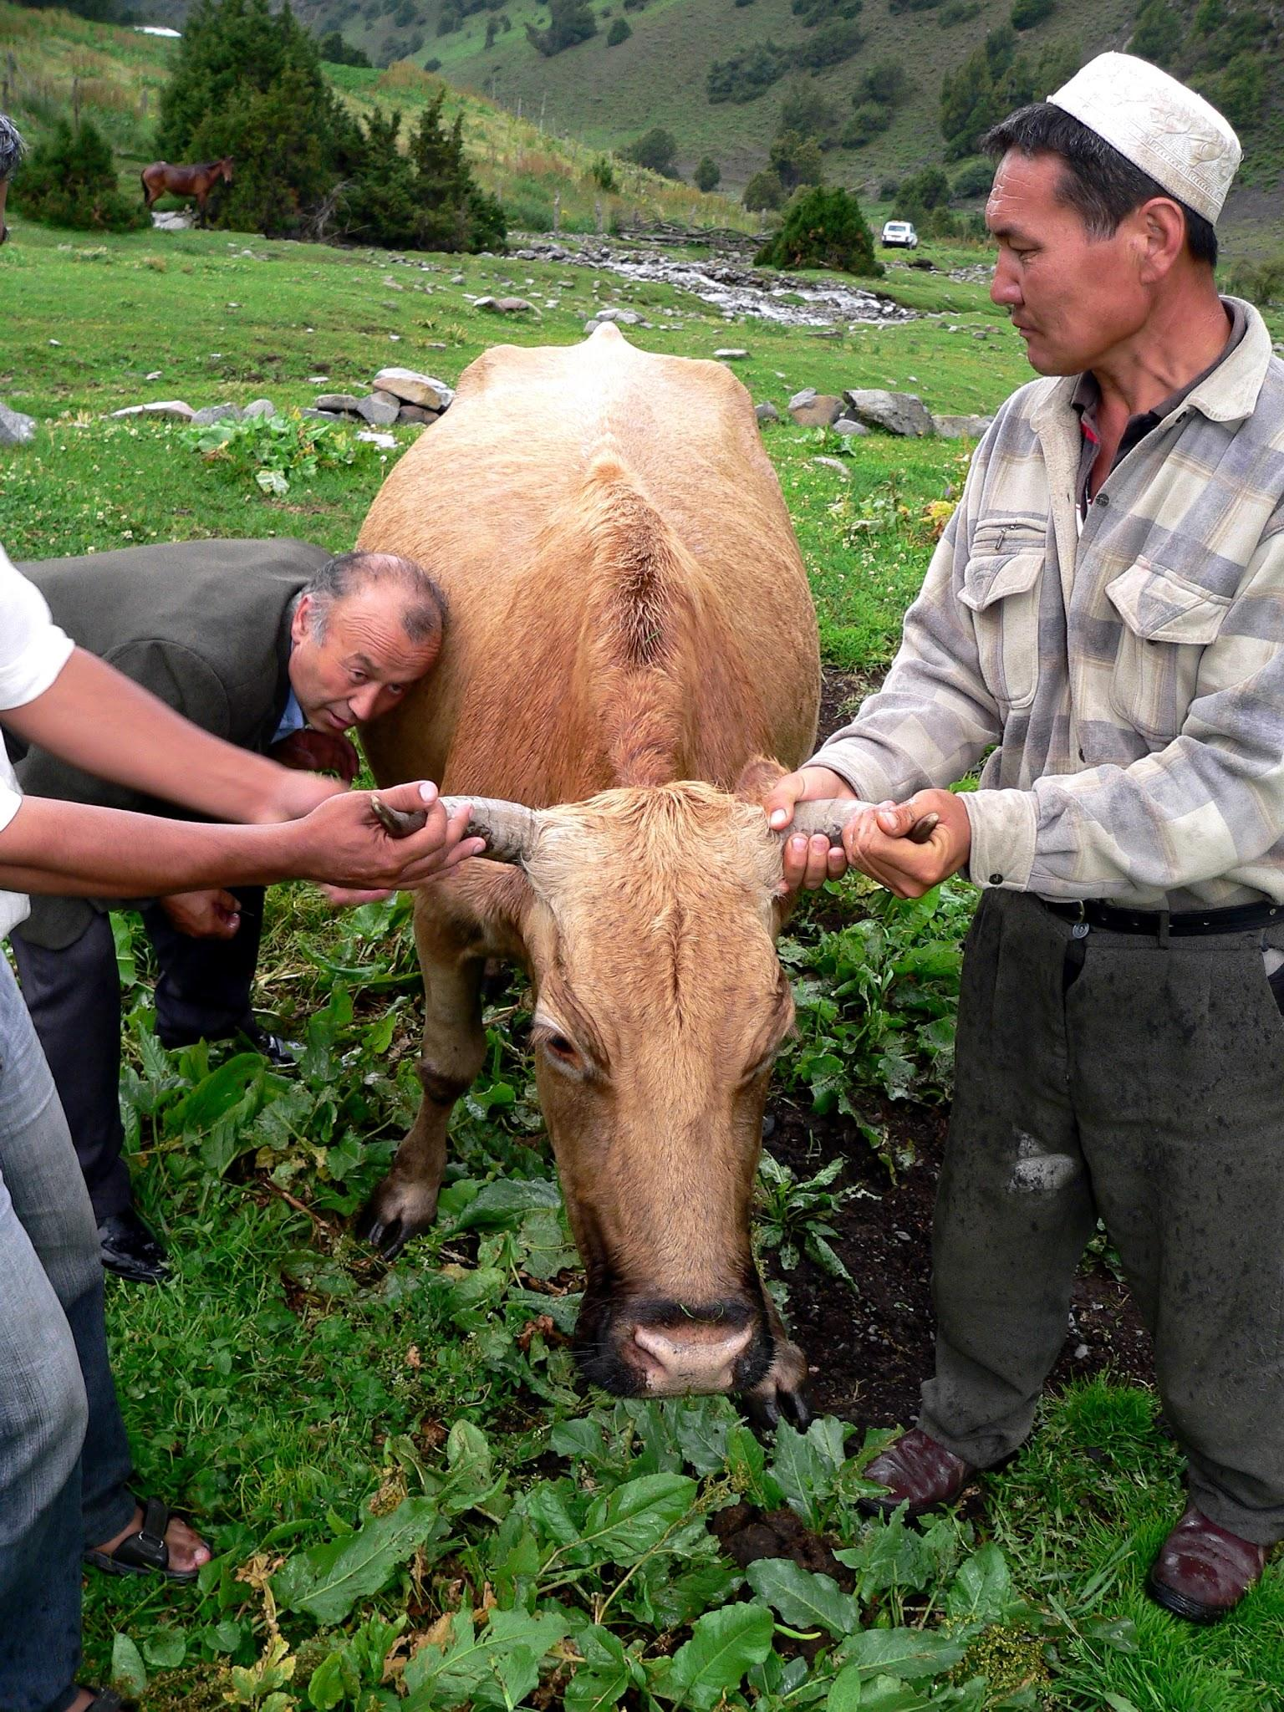
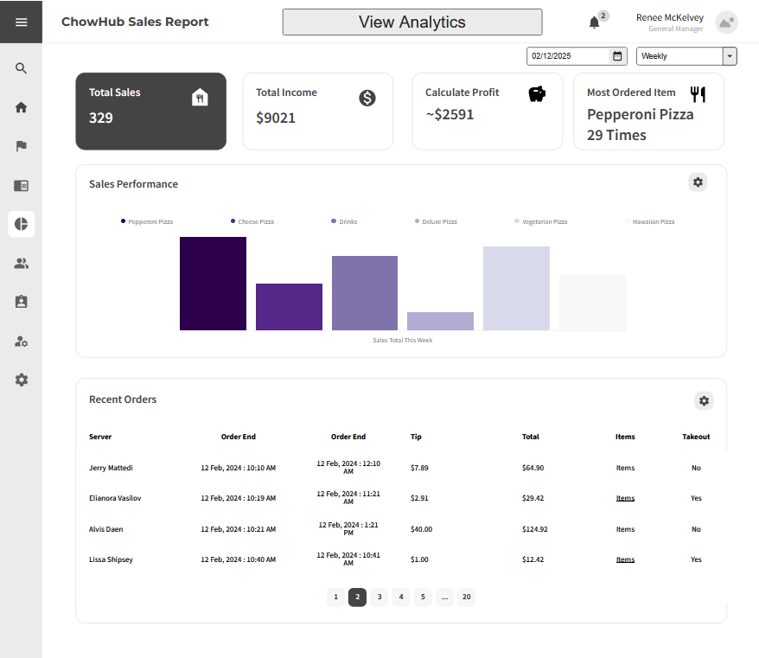
Sales Report Changing Settings
Notes:
Here, we have the sales report. This is meant to give an overview on the sales that have happened and we can change what sales it's viewing with the settings on the top right.

Slide 19

Sales Report Changing Settings
Notes:
When we click it, we get a drop down of options and if we select monthly for example.

Slide 20
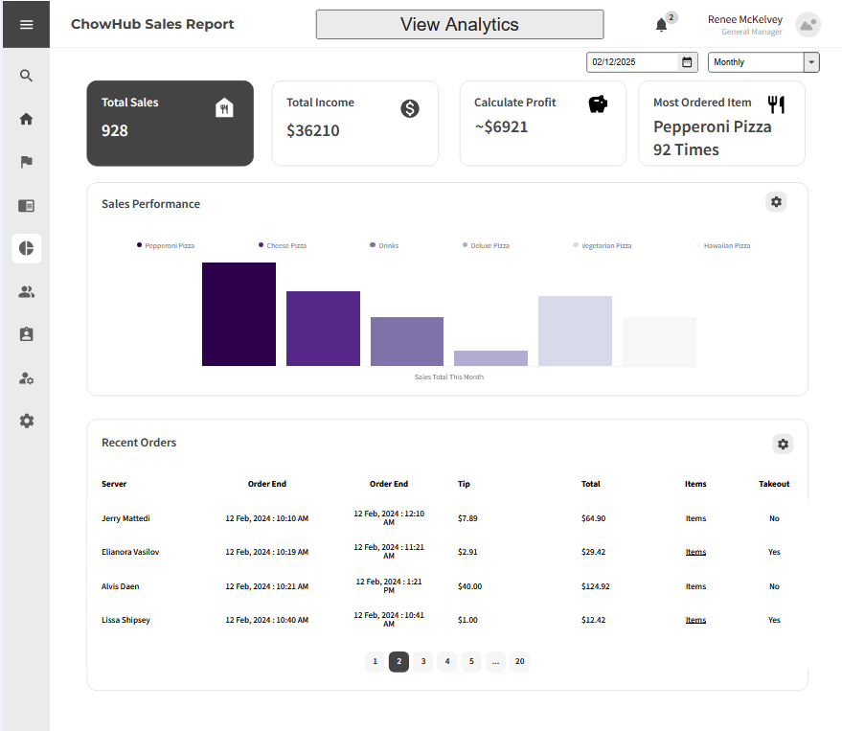
Sales Report Settings Changed
Notes:
Then it should switch the data over to a monthly report.
We can also switch over the the analytics with the bottom at the top.

Slide 21
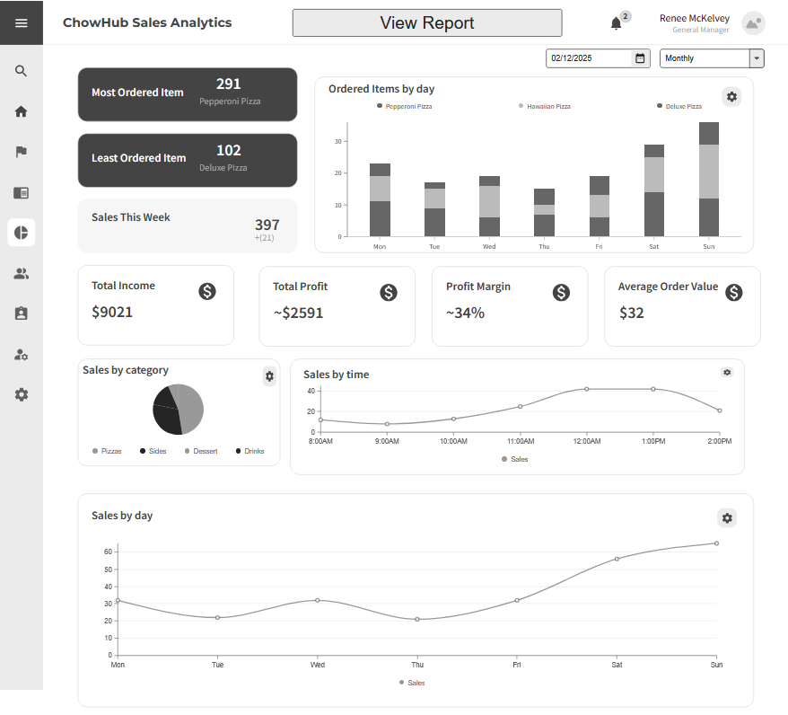
Switched to analytics
Notes:
This is where we see the analytics. We can switch back with the same button and also adjust the settings we the buttons we've seen before. This view gives us some calculated numbers based on the sales.

Slide 22
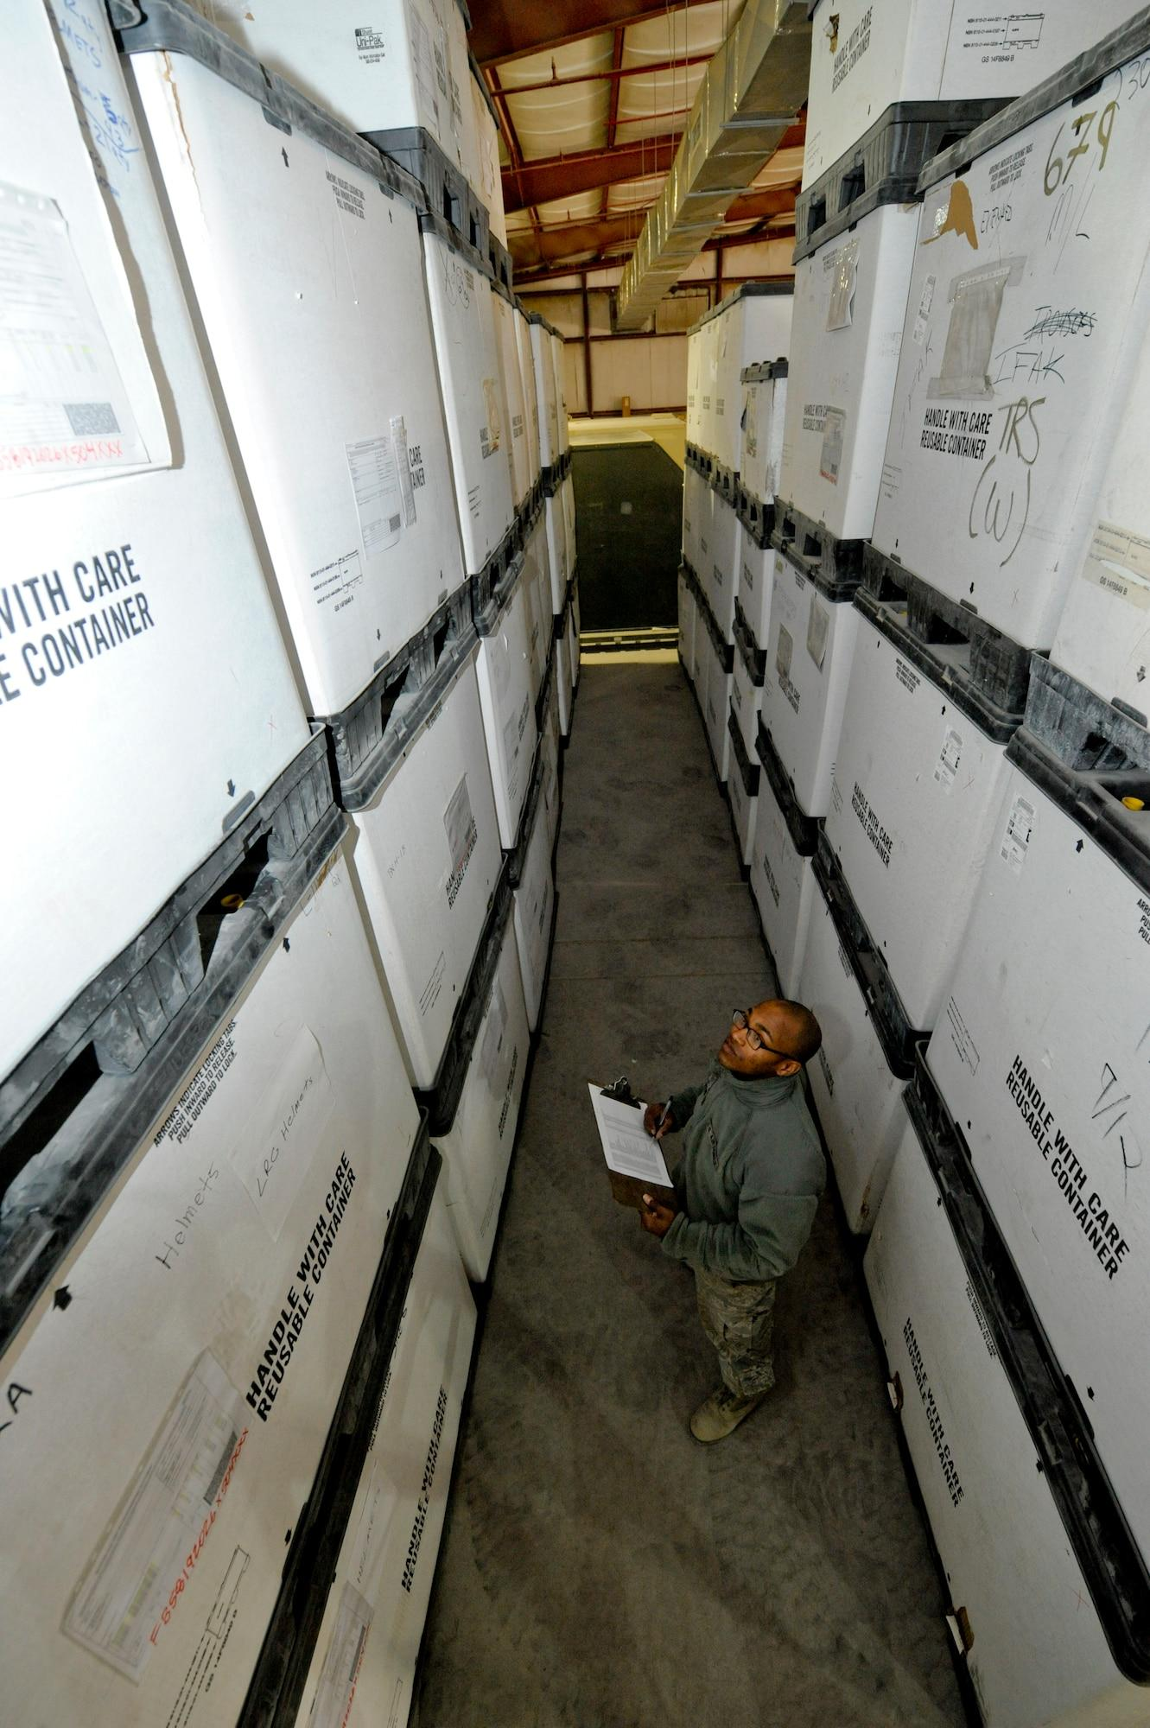
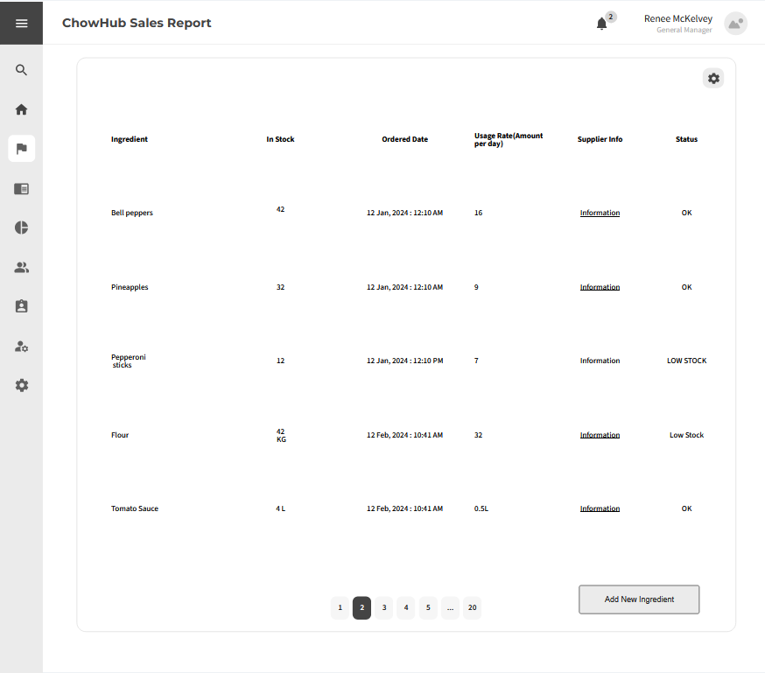
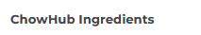
Ingredient Management Adding New Ingredient
Notes:
For the ingredient management you might want to add a new ingredient. To do that we have to press the bottom on the bottom right

Slide 23
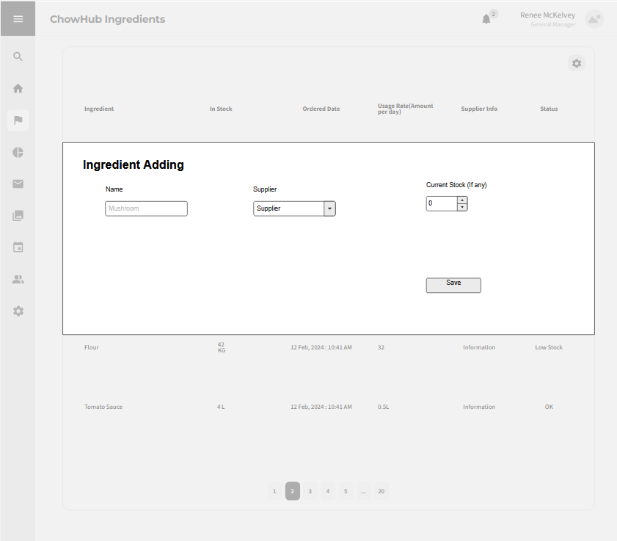
Ingredient Management Adding New Ingredient
Notes:
This opens up this menu where we can create a new ingredient. We can put in for example mushroom, and then press save.

Slide 24
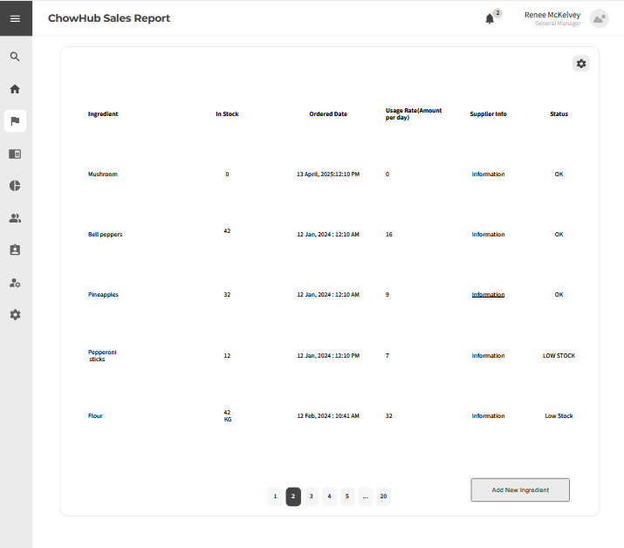
Ingredient Management Adding New Ingredient
Notes:
Then it'll save the mushroom as a new ingredient. We can also try to update an ingredient by clicking one of the ingredients

Slide 25
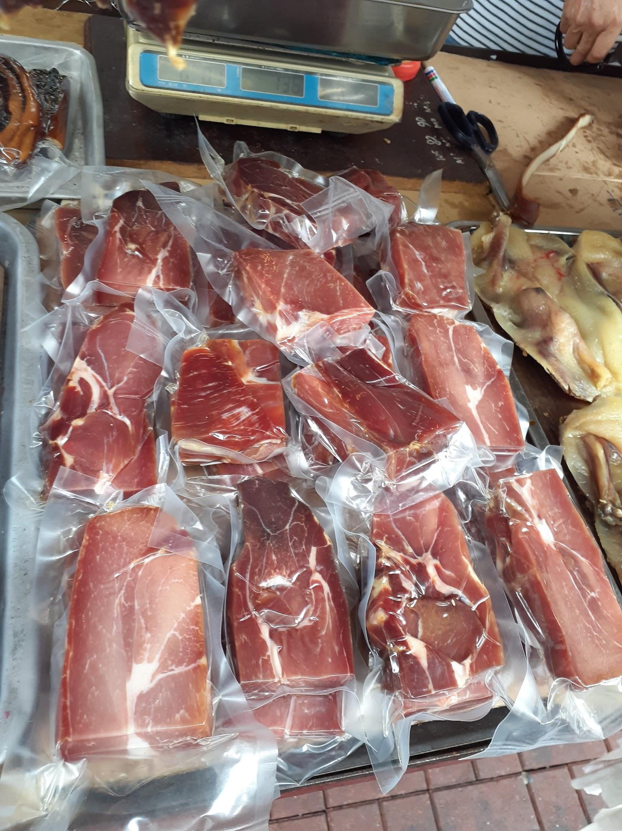
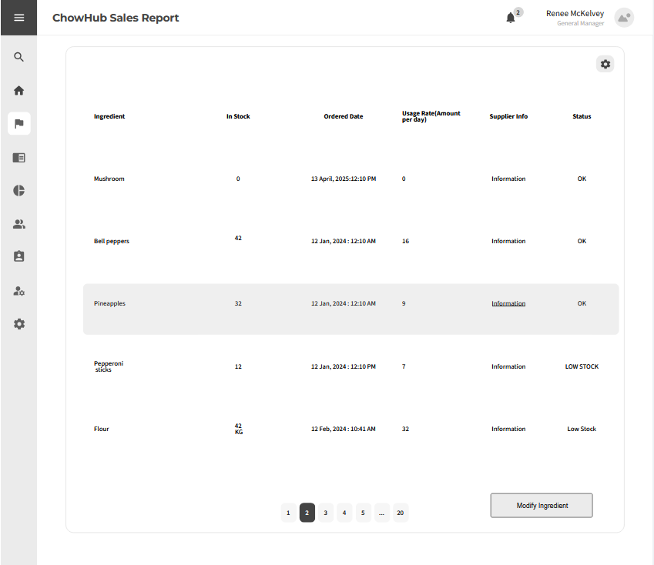
Ingredient Management Modify Existing Ingredient
Notes:
We click for example pineapples, it'll highlight it and give us an option to edit it, and if we click modify ingredient.

Slide 26
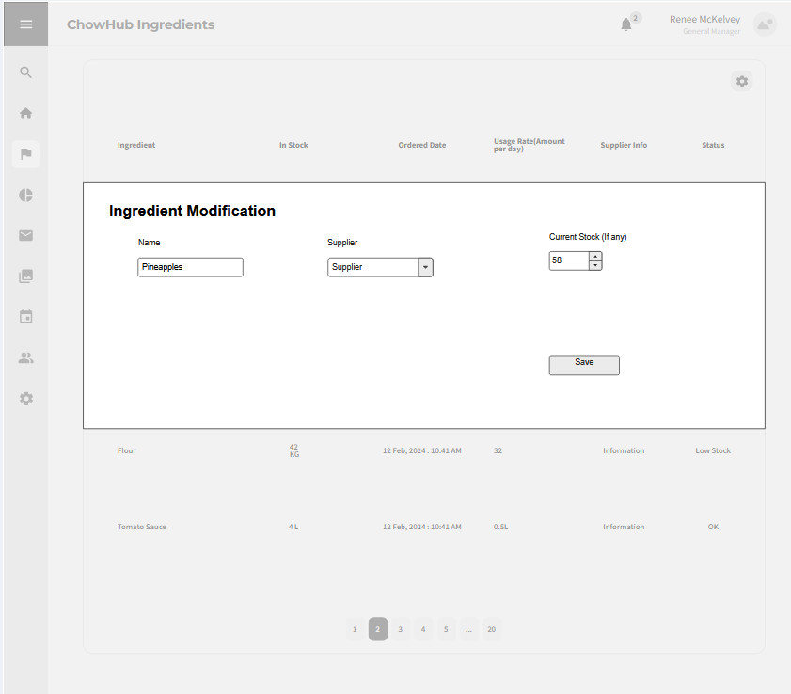
Ingredient Management Modify Existing Ingredient
Notes:
Then it should bring up this menu where we can modify it, and if we save the changes.

Slide 27
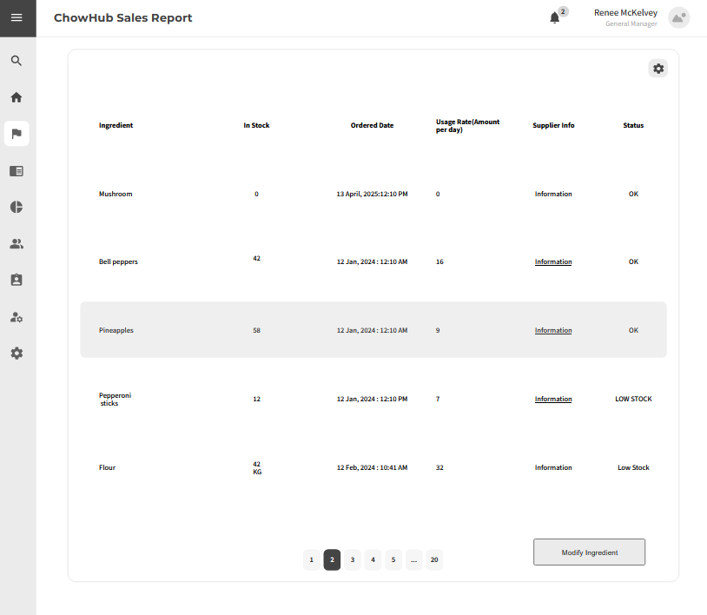
Ingredient Management Modify Existing Ingredient
Notes:
It should then be updated.

Slide 28
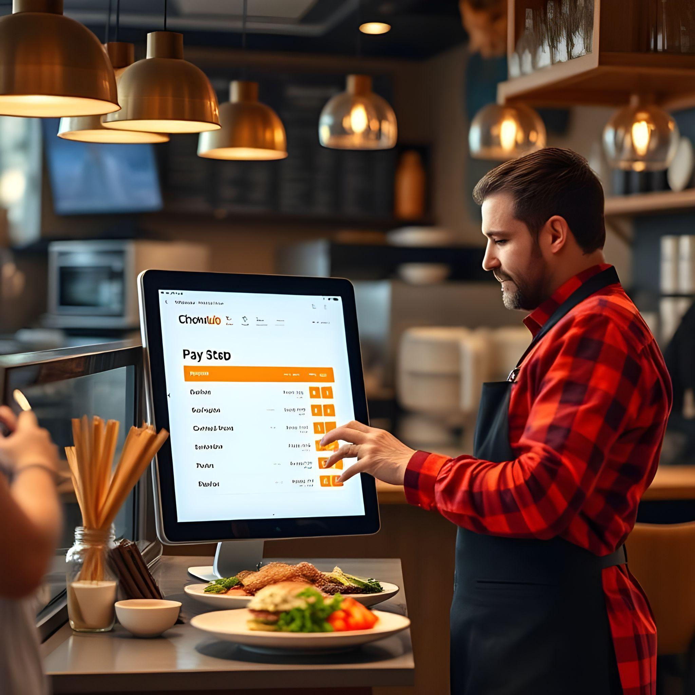
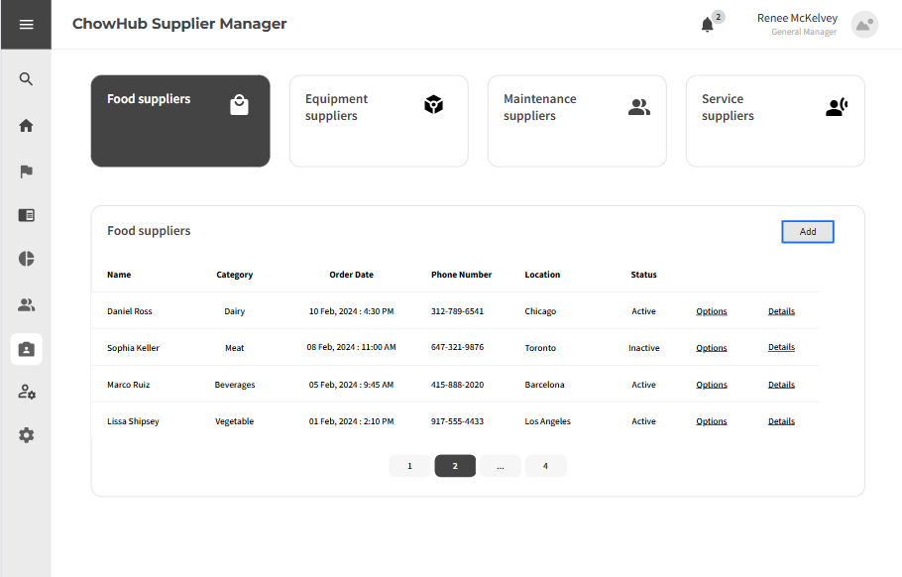
Supplier Management Add supplier
Notes:
This is thingchen again, And I will be demonstrating our supplier management with how we can add supplier and place order or request restock. We start from the supplier manager with supplier lists, on the top are different types of our suppliers and the food supplier type is selected right now, below them is the supplier list for the selected supplier type, if we wish to add a supplier, we can click on the add button highlighted by blue outline.

Slide 29
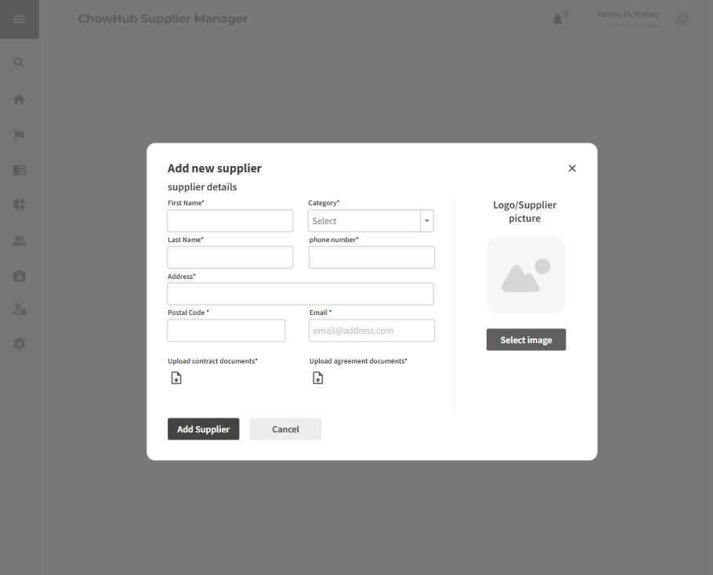
Supplier Management Add supplier
Notes:
And it will bring up add new supplier form, which the same, we fill in all required fields marked by start symble, than we can click add supplier

Slide 30
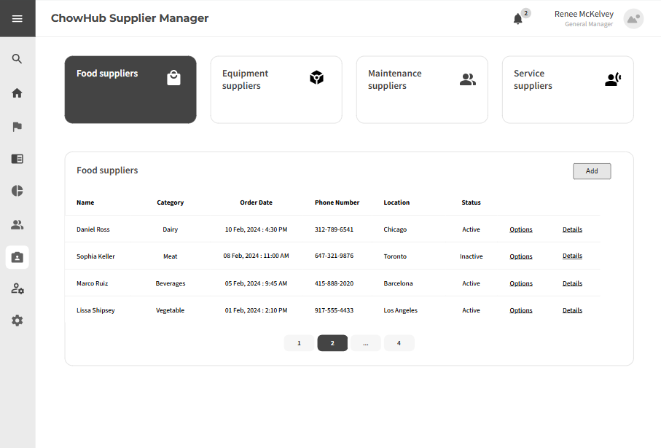
Supplier Management Add supplier
Notes:
Then we will be able to see the newly added supplier in the supplier list, and for our order or request for restock, we can click on options in each of our supplier, click on the one we want to place order or restock,

Slide 31
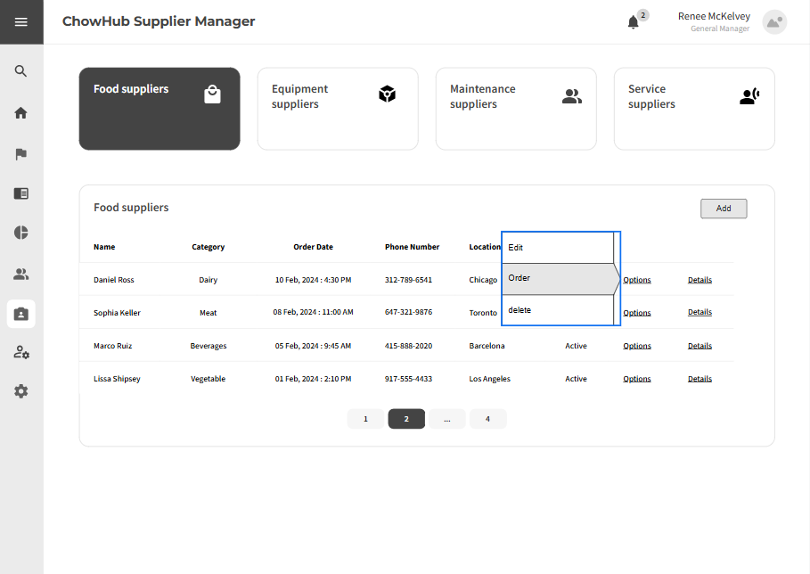
Supplier Management Add order / request restock
Notes:
Than it will bring up three option, edit , order or delete, and we select order

Slide 32
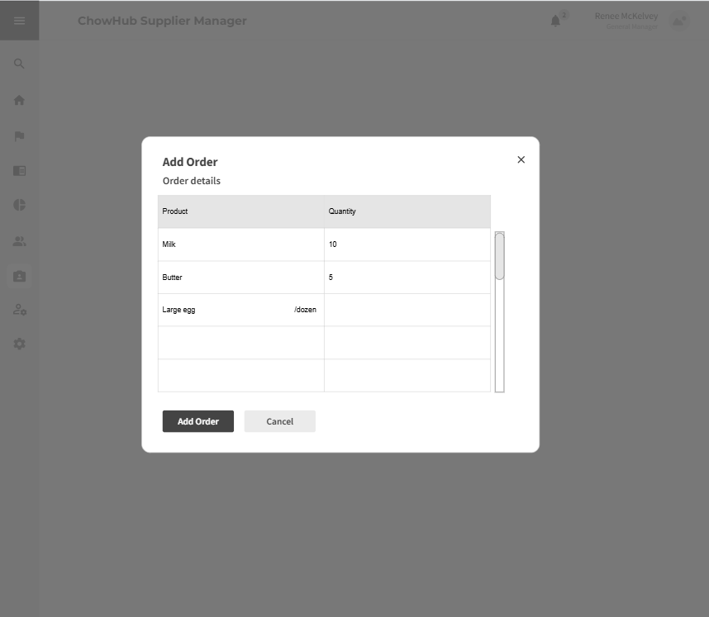
Supplier Management Add order / request restock
Notes:
After clicking the order button, it will bring up a add order form, which if there is on data in the form, means we have not yet order from the supplier, and if there is data already exist in the form, it means we are ordering again from this supplier which means restocking from this supplier, and for this form, we can simply double click on the empty table space to insert our item name and quantity data, and afterwords click add order

Slide 33
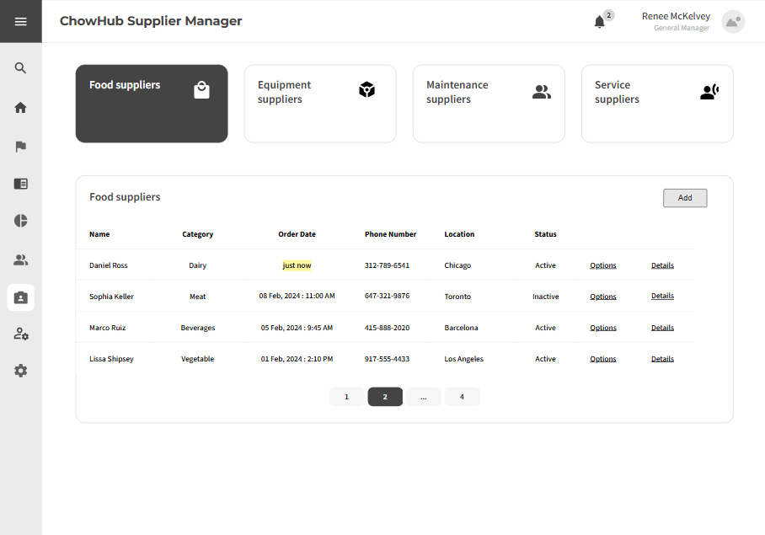
Supplier Management Add order / request restock
Notes:
The order will be placed, and our order date will be updated as well and this wraps up the supplier management demonstration, next slides will be covered by furkan bas

Slide 34
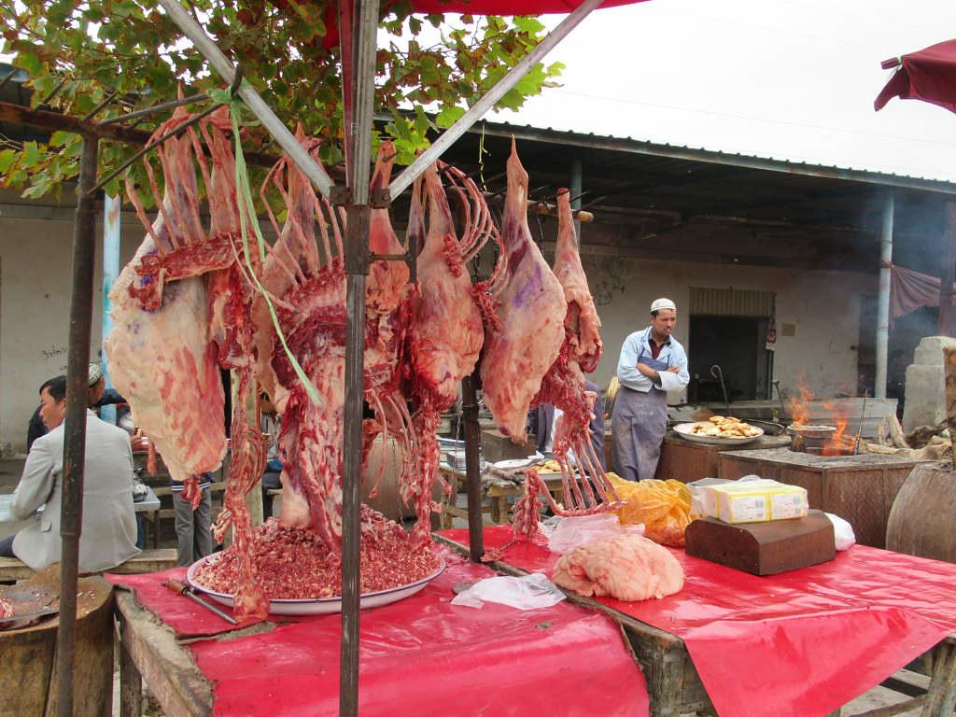

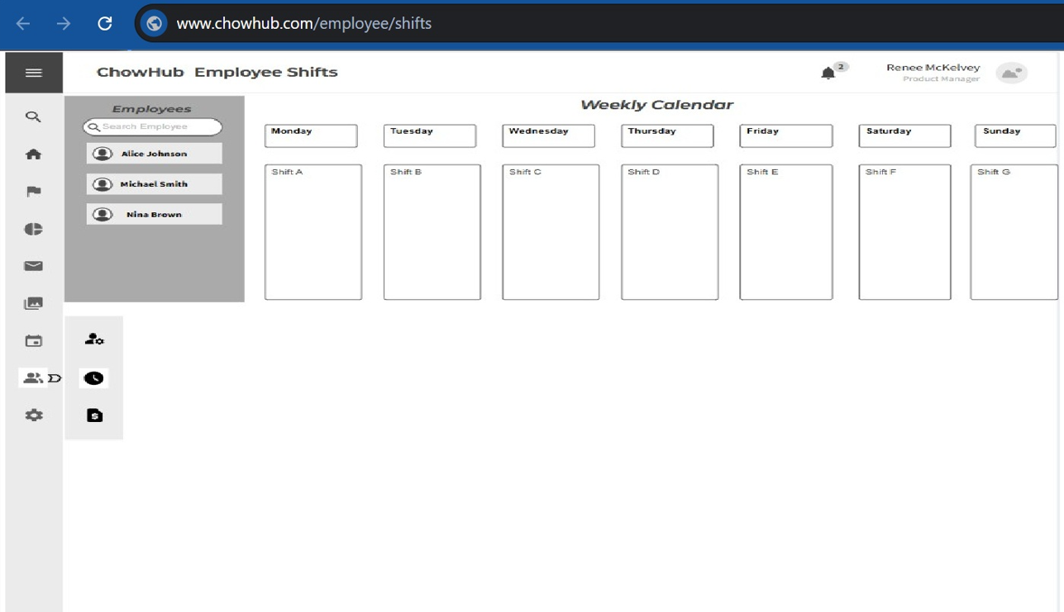
Employee Management:
Shift Calendar

Slide 35

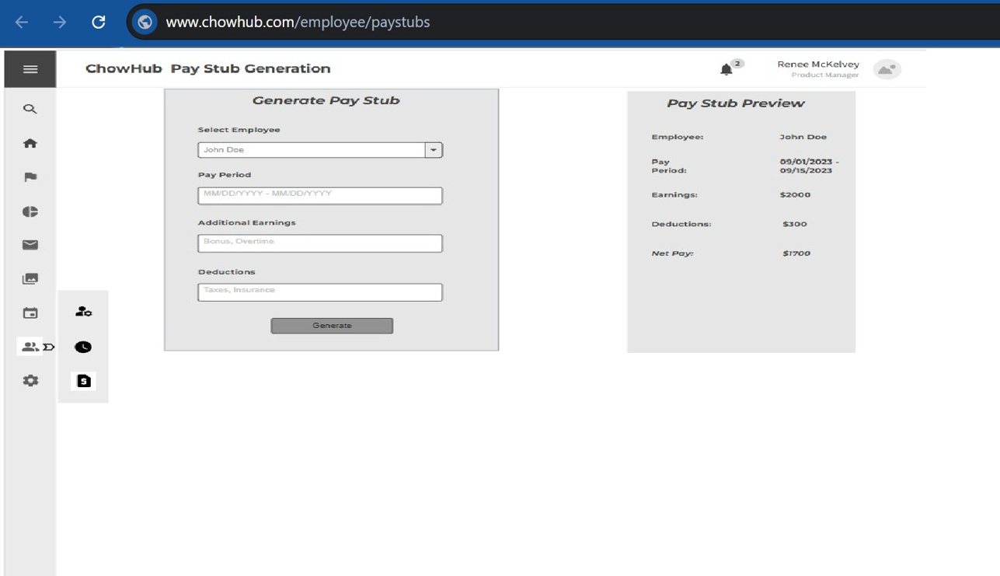
Employee Management:
Pay Stub Generation

Slide 36


Next Steps - Sprint Planning
Sprint Planning Overview
The upcoming phase will adopt the Agile Scrum methodology. Work will be structured into short, manageable iterations known as “sprints.” Typically lasting two weeks, each sprint will prioritize and address the most important user stories drawn from the backlog.
• Adopt Agile Scrum Methodology
• Break project into two-week sprints
• Prioritize tasks based on user value
• Regular reviews & feedback after each sprint

Slide 37
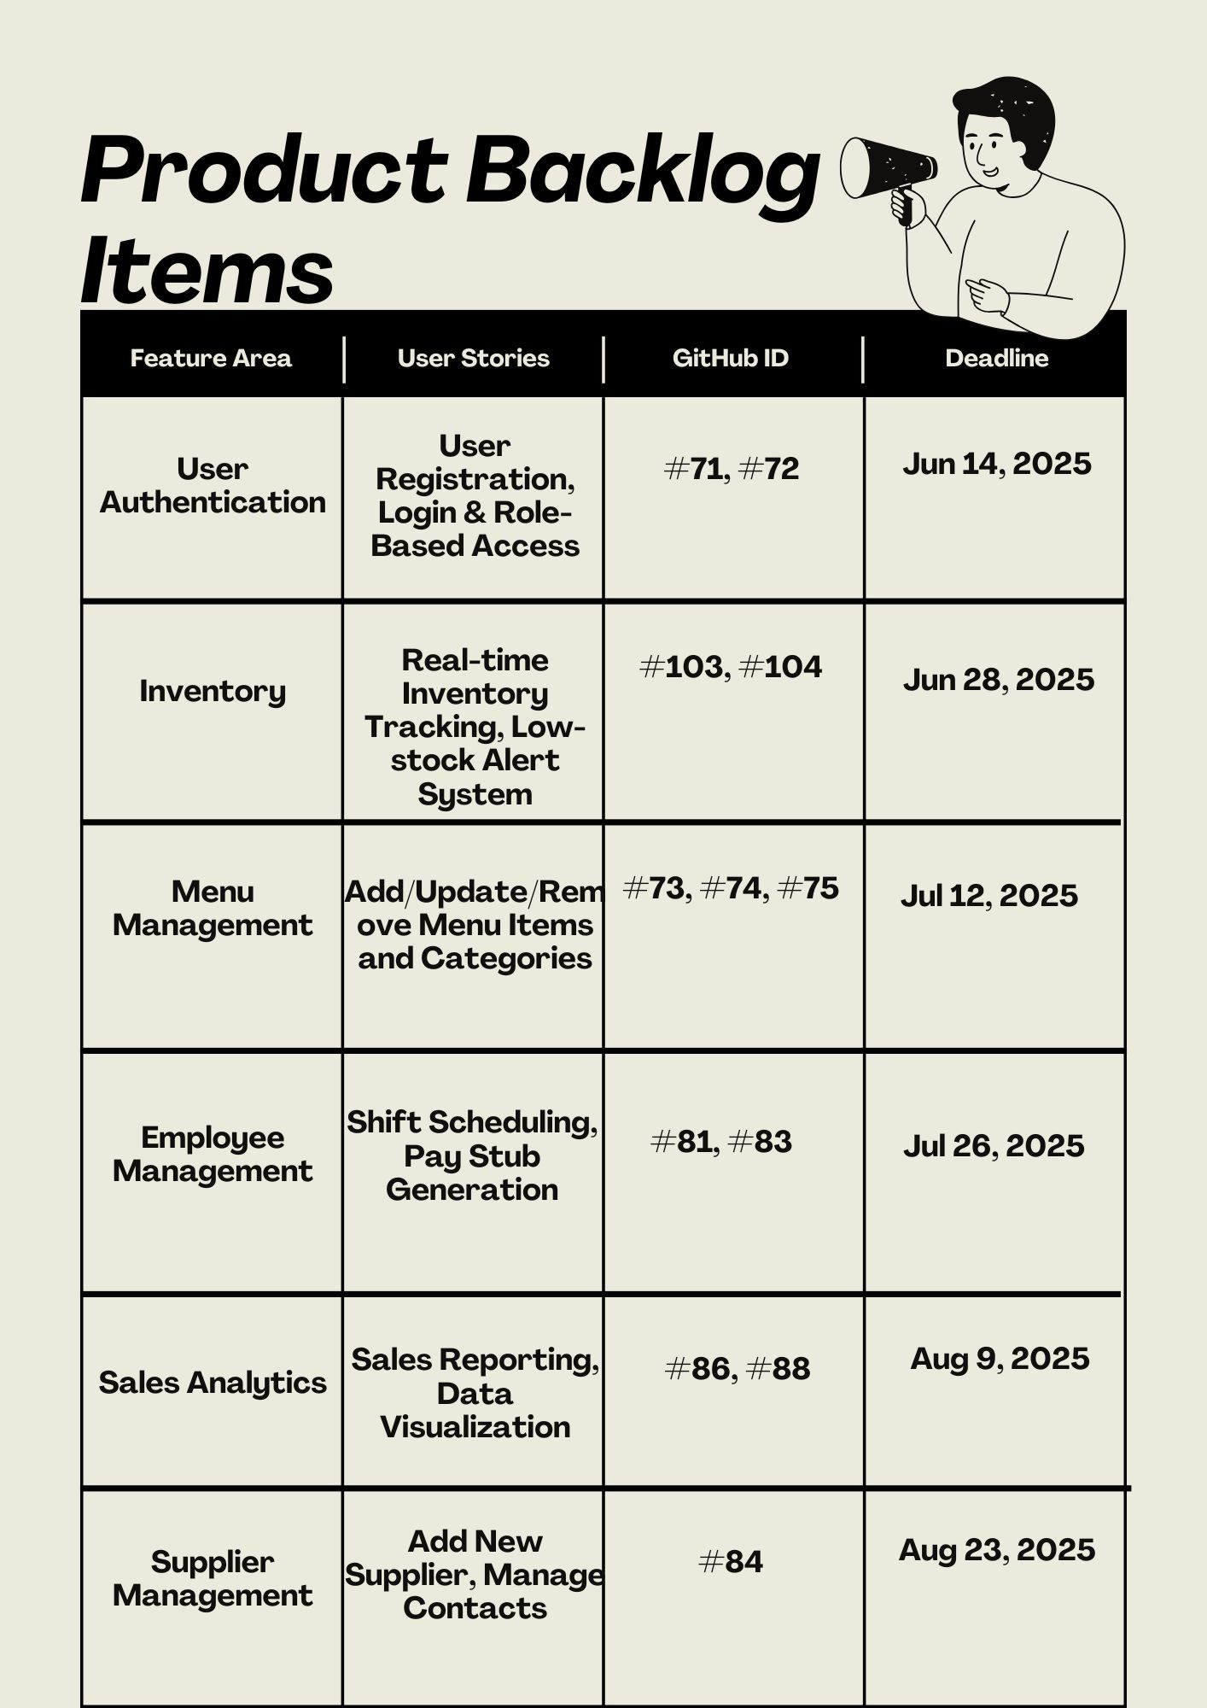
Project Backlog
Backlog Highlights
Clearly defined user stories listed in our GitHub repository .
Continuous monitoring and adjustments ensure we deliver the most value each cycle.
Stories grouped by feature
User testing and feedback sessions scheduled periodically for refinement.

Slide 38
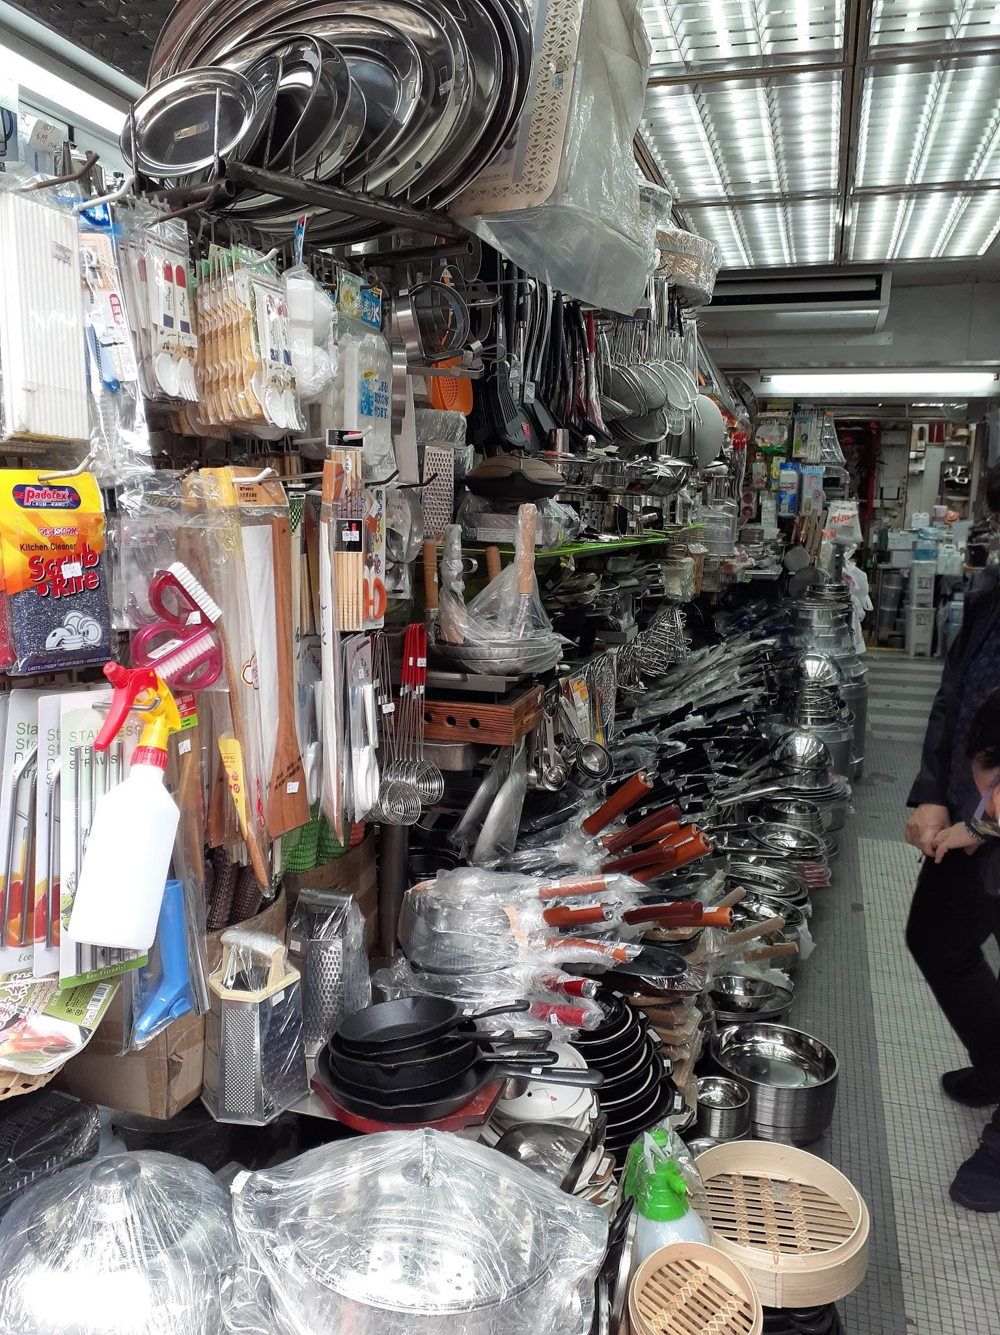
Milestones
Menu Management
Human Resource Management
Inventory Management
Order Management
Reporting & Analytics
Notes:
These are our milestones.
For menu management it's about developing a menu system where items can be added, modified, categorized, and linked with inventory availability to ensure seamless stock-based management. So We want items to be easily added, updated, removed, correctly categorized, synchronous with the inventory, and apply discounted pricing when needed.
Next we have human resources management. This is about managing suppliers and employees, so we split this into two sub milestones, supplier management, and employee management. For supplier management we want to manage supplier contact info and order information. For employee management we want to be able to manage their shifts.
Then we deal with inventory management which deals with : real-time tracking of ingredients, alerts for low stock, and efficient bulk updates for stock management.
Then onto the order management which deals with the customer order processing, kitchen communication, and POS system integration to ensure seamless order handling.
Then onto the reporting and analytics which is about creating insightful business reports for inventory, sales, payroll, and performance tracking, with data visualization to drive informed decisions. So we wanted to create meaningful data for it like total income.

